Slide 1
Using Word Embedding Model with Latent Dirichlet Allocation Model to do Topic Modeling in Law
Hongkuan Wang
22/12/2017

Slide 2
Introduction
Finding cases on a topic
Step 1
1. Develop multiple search terms to conduct research using Keyword; Browsing; Field searching
Hints:
Choose search terms that are specific or closely related to the subject matter.
Consider using abbreviations or buzzwords.
The terms should reflect ideas essential to your research topic, such as application, liability, or sentence.
Include alternative terms.
Avoid terms that are too general, such as 'duty of care' or tort
Step 2
Try some databases

Slide 3
Purpose
The purpose of this paper is to build a search engine that can find law cases with general search queries.
Queries
Search Engine
Cases

Slide 4
Method
The Method: How to find the correct documents? How should we rank those?
Queries
Find Cases
Cases
Rank Cases

Slide 5
Method
Word Embedding (word2vec)
Each unique word in the corpus being assigned a corresponding vector in the space
Words that share common contexts in the corpus are located in close proximity to one another in the space
Topic Modeling (LDA)
Posits that each document is a mixture of a small number of topics and that each word's creation is attributable to one of the document's topics
Documents with similar topic distributions are similar to each other

Slide 6
Assumption
Treat each query as a small document.
Conceive both documents and queries as a mixture of a number of topics.

Slide 7
Attempt
Word Embedding first, followed by LDA
LDA first, followed by word embedding
Find top similar words of each term, search with those terms
Compare topic distribution of queries with that of documents, and rank based on similarity.
Compare topic distribution of queries with that of documents to find similar documents
Assign each term with weight, and rank with the weight of each document.

Slide 8
Reasons
Reason for choosing method 1
Generally fast
Common topic modeling techniques for document modeling often face sparsity problems with search query data as these are much shorter than documents.
(example: a document that has 3 topics, “car accident”, “destroy evidence” and “murder”.
the query only has 2 topic, “destroy evidence” and “murder”.)

Slide 9
DAtabase
Database: Supreme Court of New South Wales
Size: 1.1GB

Slide 10
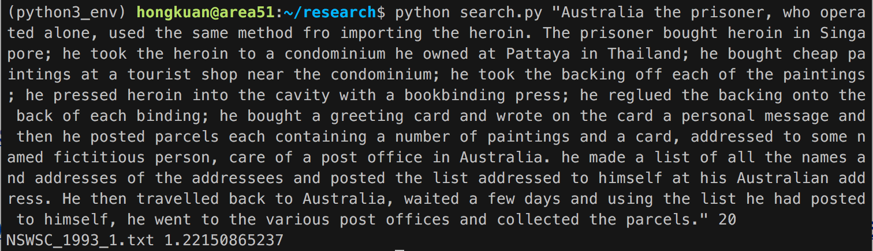
Results
Query: Australia the prisoner, who operated alone, used the same method fro importing the heroin. The prisoner bought heroin in Singapore; he took the heroin to a condominium he owned at Pattaya in Thailand; he bought cheap paintings at a tourist shop near the condominium; he took the backing off each of the paintings; he pressed heroin into the cavity with a bookbinding press; he reglued the backing onto the back of each binding; he bought a greeting card and wrote on the card a personal message and then he posted parcels each containing a number of paintings and a card, addressed to some named fictitious person, care of a post office in Australia. he made a list of all the names and addresses of the addressees and posted the list addressed to himself at his Australian address. He then travelled back to Australia, waited a few days and using the list he had posted to himself, he went to the various post offices and collected the parcels. (NSWSC_1993_1.txt)
Result:

Slide 11
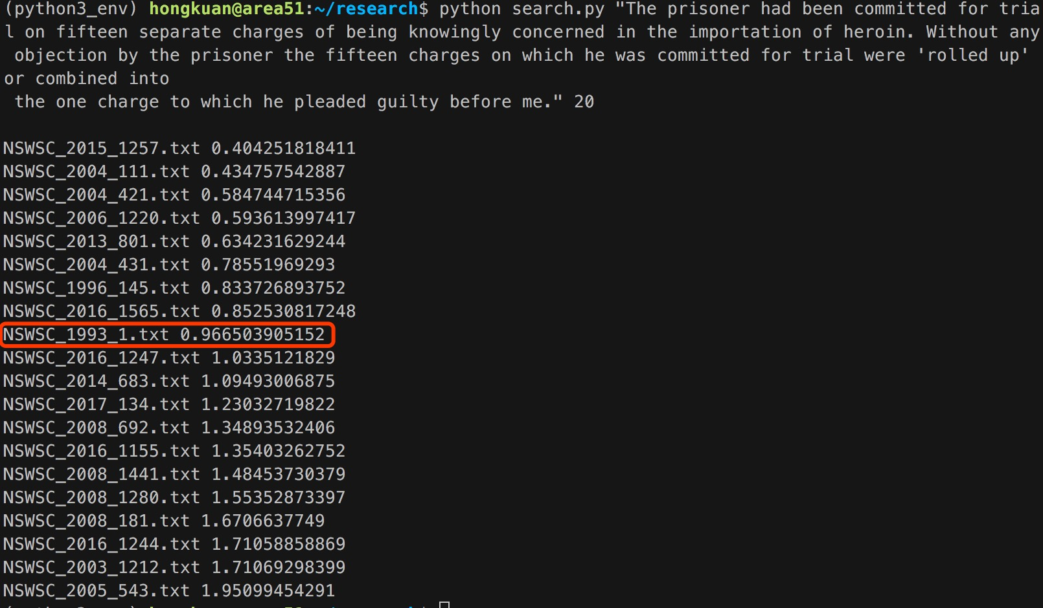
Result
Query: The prisoner had been committed for trial on fifteen separate charges of being knowingly concerned in the importation of heroin. Without any objection by the prisoner the fifteen charges on which he was committed for trial were "rolled up" or combined into the one charge to which he pleaded guilty before me. (NSWSC_1993_1.txt)
Result:

Slide 12
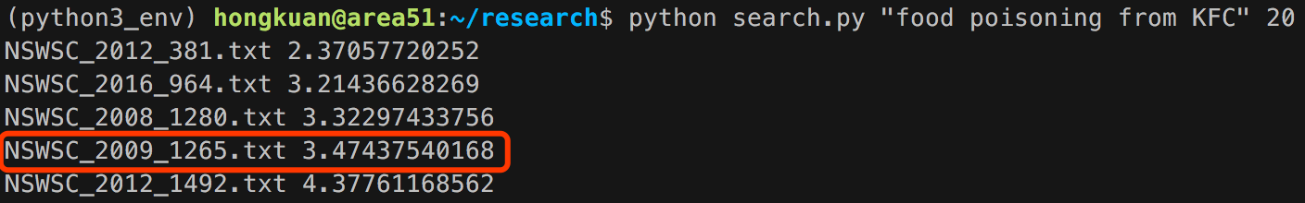
result
Query: food poisoning from KFC
Sample Doc: JUDGMENT HIS HONOUR: This proceeding concerns an application by Kentucky Fried Chicken Pty Ltd ("KFC"), the defendant, to amend its pleadings and to withdraw admissions. Ms Samaan, the plaintiff, opposes the application. The plaintiff's claim, commenced on 10 November 2006, alleges that she ate chicken at a KFC store, contracted salmonella poisoning, and suffered severe consequential brain damage. (NSWSC_2009_1265.txt)

Slide 13
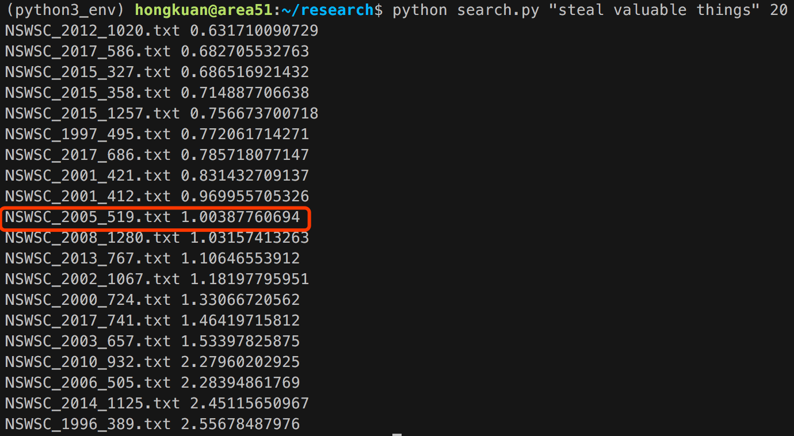
result
Query: steal valuable things
Sample Doc: He stole money and valuable property, including jewellery, computer equipment and mobile telephones. Because he was wearing the gloves he left no fingerprints.

Slide 14
Ranking
Query: steal valuable things
Query topic distribution: topic[25] = 0.518; topic[40]=0.238
Doc topic distribution:
NSWSC_2012_1020.txt: topic[25]=0.859; topic[40]=0.000008 …The offender's intent in engaging Mr Brown was to take anything valuable from him…
NSWSC_2017_586.txt topic[25]=0.838; topic[40]=0.000006 …he committed the offence of break, enter and steal,…
NSWSC_2015_327.txt topic[25]=0.808; topic[40]=0.0000048 …Children's Court entries for offences of larceny, steal motor vehicle,…
NSWSC_2015_358.txt topic[25]=0.818; topic[40]=0.000008 …attempting with his co-offender to steal any valuable property…

Slide 15
drawback
LDA is cannot provide the best topic modeling result for law cases
Example:
NSWSC_2012_1020.txt: …The offender's intent in engaging Mr Brown was to take anything valuable from him…
NSWSC_2017_586.txt …he committed the offence of break, enter and steal,…
Sentence -–muder and manslaughter
NSWSC_2015_327.txt …Children's Court entries for offences of larceny, steal motor vehicle,…
NSWSC_2015_358.txt …attempting with his co-offender to steal any valuable property…

Slide 16
Conclusion
All the search results are desirable.
Topic distribution generated by LDA does not reflect the true topic of some law cases.
The search engine is usable.

Slide 17
Thank you

